Slide 1
FOREX PREDICTION
Predicting the Foreign Exchange of USD
Vigneshwarr Venkatesan

Slide 2
Project Purpose
Success is FOREX market depends on the ability to skilfully predict the movements in the market.
Human prediction is based on instinct or experience but the error rate is very high.
Constructing a programming model based on machine learning algorithms using past data is a viable option.

Slide 3
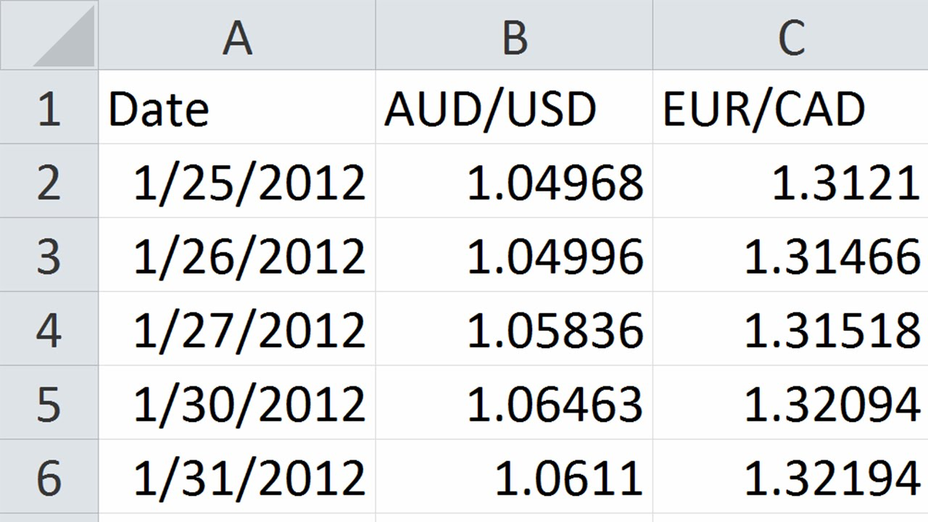
Raw Forex Data

Slide 4
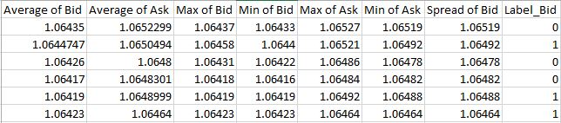
Preparing the Data
Create a labeled data matrix that can be used by a machine-learning algorithm for regression or classification. You will need to write some program to accomplish this.

Slide 5
Analytic Approach - 1
Constructing Random Forest
Using the data matrix that is created, create a simple decision tree model to learn how to predict the labels you have given your data.
Using this single decision tree, create an ensemble of trees to create a Random Forest.
Train the Random Forest using the training data and predict the results for the test data.

Slide 6
Results
Ran the project for different number of trees as input.
Initial error rate of around 39%. Later I tried with increasing the number of trees till 100. There was slight increase in the accuracy level of the random forest. Below are the tables showing the % of accuracy and the % of Error rate with respect to the number of trees as input to the random forest. Finally I ran with 100 as the number of trees with the error rate of 32%.

Slide 7
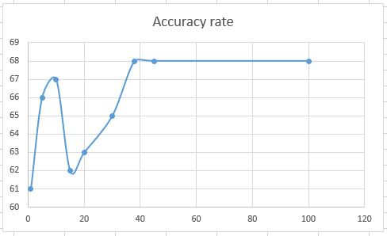
Error Analysis
Number of trees in the random forest | Accuracy %
1 | 61
5 | 66
10 | 67
15 | 62
20 | 63
30 | 65
38 | 68
45 | 68
100 | 68
Number of trees in the random forest | Error %
1 | 39
5 | 34
10 | 33
15 | 38
20 | 37
30 | 35
38 | 32
45 | 32
100 | 32

Slide 8
Actionable Information or Insights
This Random Forest Model doesn’t work for huge data sets.
It has to be implemented on data distribution systems to handle large data sets.

Slide 9
Analytic Approach - 2
Random Forest on Hadoop
The term MapReduce actually refers to two separate and distinct tasks that Hadoop programs perform. The first is the map job, which takes a set of data and converts it into another set of data, where individual elements are broken down into tuples (key/value pairs). The reduce job takes the output from a map as input and combines those data tuples into a smaller set of tuples. As the sequence of the name MapReduce implies, the reduce job is always performed after the map job.

Slide 10
Analytic Approach - 2
Random Forest on Hadoop
Create a MapReduce implementation of the random forest.
Here the data is divided into different chunks and parallel processing of data happens in clusters.

Slide 11
Results

Slide 12
Analysis
One of the main limitations of MapReduce is that it persists the full dataset to HDFS after running each job. This is very expensive, because it incurs both three times (for replication) the size of the dataset in disk I/O and a similar amount of network I/O. MapReduce starts a new JVM for each task, which can take seconds with loading JARs, JITing, parsing configuration XML, etc.

Slide 13
Using Spark
Spark ideal for workloads where multiple operations access the same input data. Users can instruct Spark to cache input data sets in memory, so they don't need to be read from disk for each operation. Spark's shuffle implementation works very similarly to MapReduce's: each record is serialized and written out to disk on the map side and then fetched and deserialized on the reduce side.

Slide 14
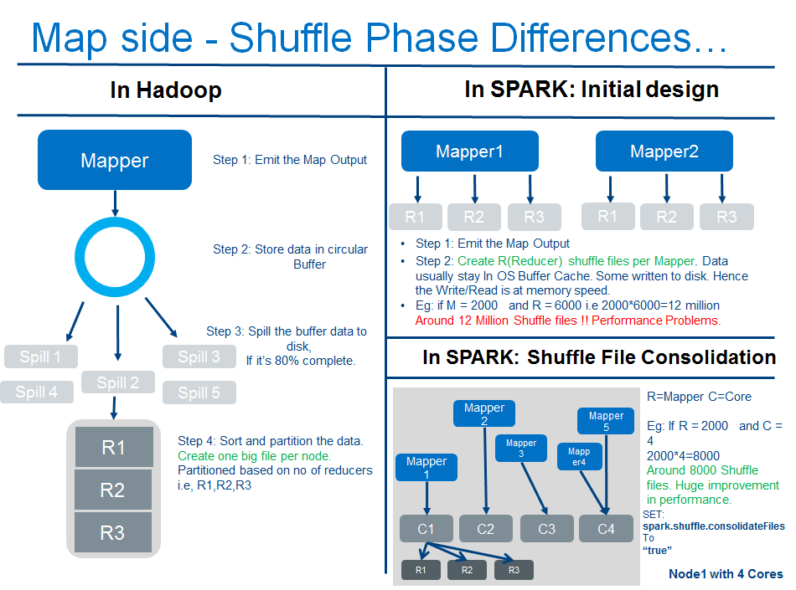
Analytic Approach - 3
Random Forest on Spark - 1
Sources: Page on berkeley.edu
Notes:
Map Side of Hadoop Map Reduce ( see left side of the image above ): Each Map task outputs the data in Key and Value pair.
The output is stored in a CIRCULAR BUFFER instead of writing to disk.
The size of the circular buffer is around 100 MB. If the circular buffer is 80% full by default, then the data will be spilled to disk, which are called shuffle spill files.
On a particular node, many map tasks are run as a result many spill files are created. Hadoop merges all the spill files, on a particular node, into one big file which is SORTED and PARTITIONED based on number of reducers.
Map side of Spark ( see right side of the image above) Initial Design:
The output of map side is written to OS BUFFER CACHE.
The operating system will decide if the data can stay in OS buffer cache or should it be spilled to DISK.
Each map task creates as many shuffle spill files as number of reducers.
SPARK doesn't merge and partition shuffle spill files into one big file, which is the case with Apache Hadoop.
Example: If there are 6000 (R) reducers and 2000 (M) map tasks, there will be (M*R) 6000*2000=12 million shuffle files. This is because, in spark, each map task creates as many shuffle spill files as number of reducers. This caused performance degradation.
This was the initial design of Apache Spark.
Shuffle File Consolidation: Same as above.
The only difference being, the map tasks which run on the same cores will be consolidated into a single file. So, each CORE will output as many shuffle files as number of reducers.
Example: If there are 6000(R) and 4 (C) Cores, the number of shuffle files will be (R*C) 6000*4=8000 shuffle files. Note the huge change in the number of shuffle files.

Slide 15
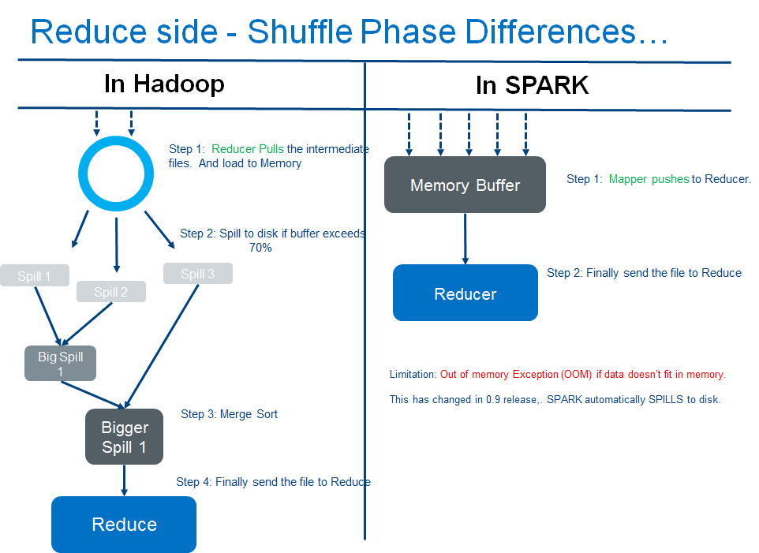
Analytic Approach - 3
Random Forest on Spark - 2
Sources: Page on berkeley.edu
Notes:
Reduce side of Hadoop MR:
PUSHES the intermediate files(shuffle files) created at the map side. And the data is loaded into memory.
If the buffer reaches 70% of its limit, then the data will be spilled to disk.
Then the spills are merged to form bigger files.
Finally the reduce method gets invoked.
Reduce side of Apache Spark:
PULLS the intermediate files(shuffle files) to Reduce side.
The data is directly written to memory.
If the data doesn't fit in-memory, it will be spilled to disk from spark 0.9 on-wards. Before that, an OOM(out of memory) exception would be thrown.
Finally the reducer functionality gets invoked.

Slide 16
Results

Slide 17
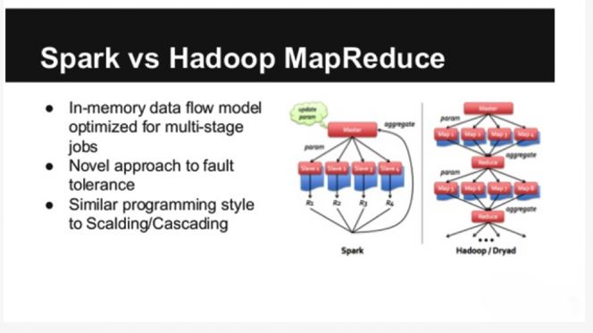
Hadoop and Spark
Notes:
Hadoop MapReduce reverts back to dick following a map and/or reduce action, while Spark processes data in-memory. Performance-wise, as a result, Apache Spark outperforms Hadoop MapReduce.
On the flip side, spark requires a higher memory allocation, since it loads processes into memory and caches them there for a while, just like standard databases. Where Spark is running on YARN alongside other resource-intensive services, or where the data is too big for the memory, the result is significant performance degradation for Apache Spark. However, MapReduce kills processes on job completion, therefore can be seamlessly run alongside resource-intensive services without majorly affecting performance.
Considering iterative computations on the same block of data, Spark maintains the upper hand. When considering single-pass ETL tasks like data integration or transformation, MapReduce is the better option.

Slide 18
Future Work
Spark’s integration with Hadoop is relatively new, it can be time-consuming to get it working. Fortunately, CDH hides that complexity by integrating Spark and managing setup of its processes.

Slide 19
Conclusion
Thank You

